Slide 1


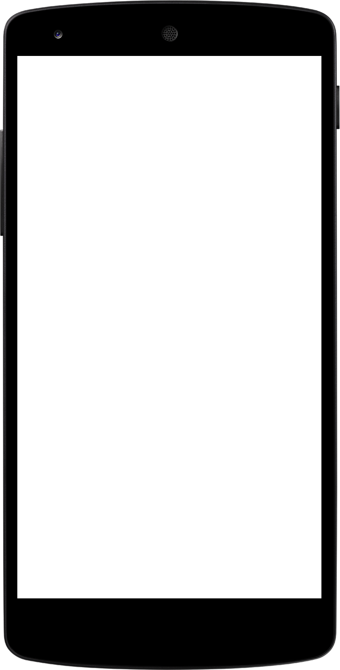
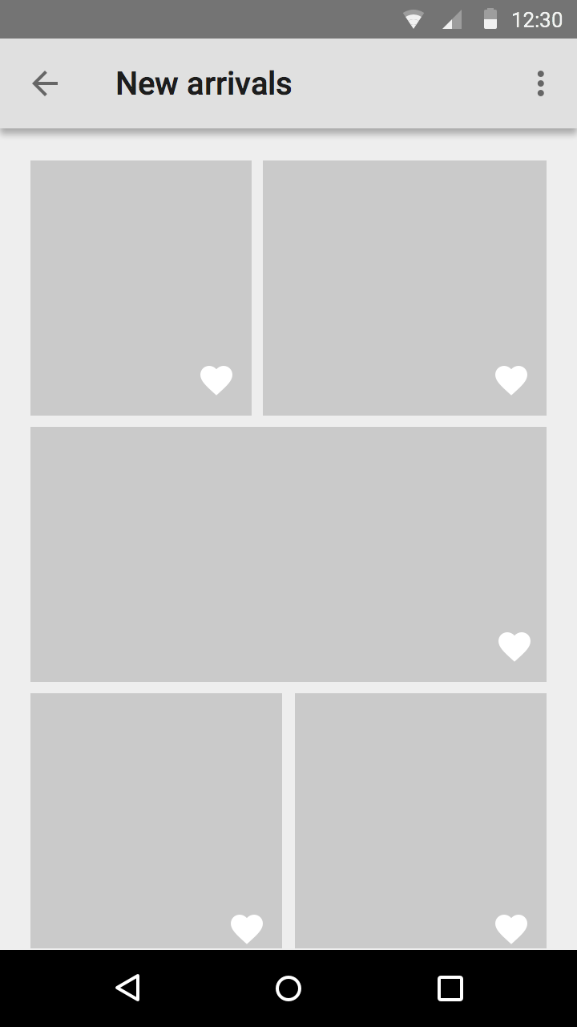
WEB DEVELOPMENT
Aditya Raman

Slide 2
WEB DEVELOPMENT
Aditya Raman

Slide 3
LET’S BEGIN
WHAT IS THIS ?
WHY THIS ?
HOW ?
WHERE TO BEGIN ?
WHAT TO DO ?
YES, I AM READY !

Slide 4
WEB DEVELOPMENT ???

Slide 5
WHAT IS WEB DEVELOPMENT ?
Web Development is the planning and creation of websites.
It deals with the process of developing a website.
Web development ranges from creating plain text pages to complex web-based applications, social network applications and electronic business applications.

Slide 6
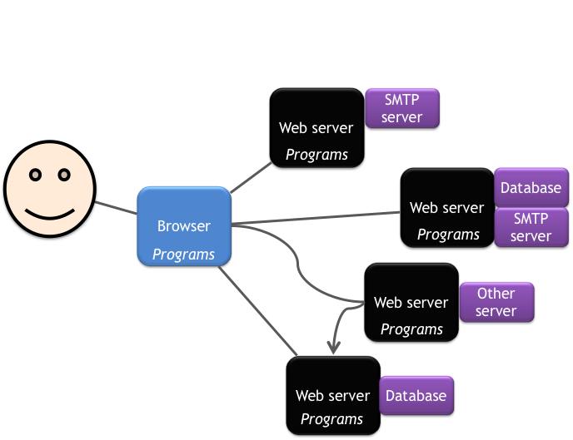
What the web is ?

Slide 7
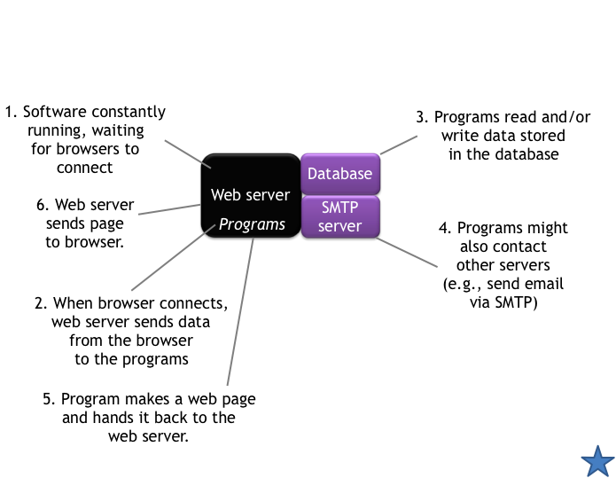
What a web application is ?

Slide 8
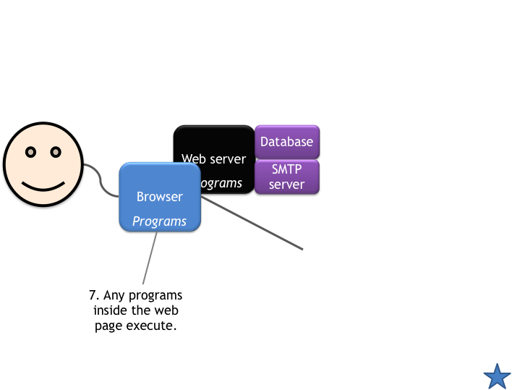
Web pages can contain programs too.

Slide 9
WHY ???

Slide 10
Why you should ???
What is the purpose and goal of your website?
What is your expected outcome from your Website?
How much money and time are you willing to spend on your website?
Who is your target audience and how will your website be designed to reach them?

Slide 11
HOW ???

Slide 12
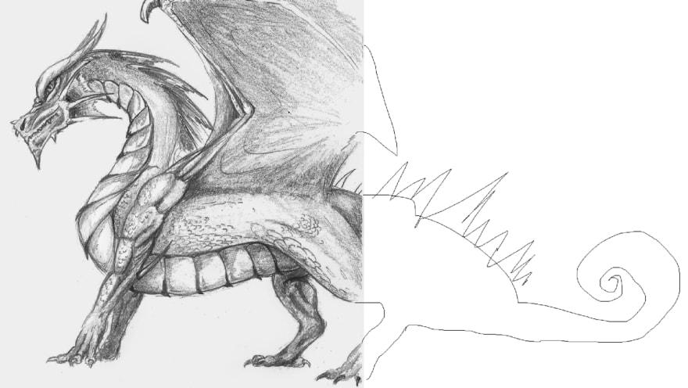
Contact
HTML
Your Name
no_reply@example.com
www.example.com
HTML + CSS

Slide 13
The web development hierarchy is as follows:
Client-side coding
Server-side coding
Database technology

Slide 14
Client ?
A client is a computer hardware device or software that accesses a service made available by a server. The server is often (but not always) located on a separate physical computer.

Slide 15
Server ?
A server is a physical computer dedicated to run services to serve the needs of other computers. Depending on the service that is running, it could be a file server, database server, home media server, print server, or web server.

Slide 16
Primary technologies for the web
Markup Languages
HTML, DHTML, XML, XSLT, etc....
Cascading Style Sheets (CSS)
Scripting languages
perl,javascript,php, etc....
Web creation and editing software
Notepad, FrontPage, Coldfusion, Flash, Hotmetal, Site Builder, etc..

Slide 17
Speaker’s Suggestion
HTML,CSS,
JavaScript
Python
Sqlite/
MySQL/
MongoDB
Django/
Flask

Slide 18
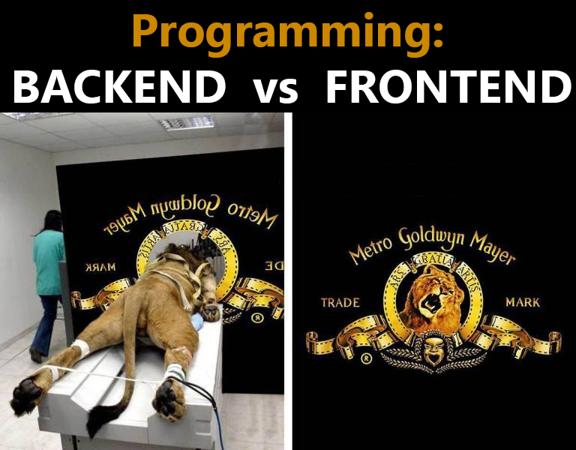

Slide 19
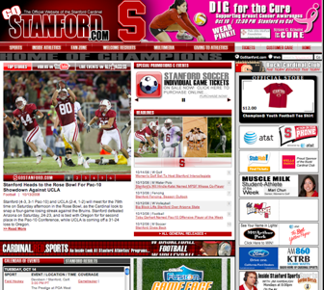
Content is important, but content alone will not make your site work.

Slide 20
12 Principles of ‘GOOD’ web design

Slide 21
Visitor-centric, clear purpose
2. Progressive disclosure

Slide 22
3. Displays quickly
4. Browser compatible

Slide 23
5. Intuitive navigation
6. Spelling, grammar, writing

Slide 24
7. Secure (eCommerce)
8. Attractive design, easy to read

Slide 25
9. Cultural bias? (Regional? Domestic? International?)
10. No technical problems (broken links, buggy scripts)

Slide 26
11. Maintainable (separate content from style)
12. Search Engine Accessible

Slide 27
Future of Web Development

Slide 28
WebRTC
WebRTC is a free, open project that provides browsers and mobile applications with Real-Time Communications (RTC) capabilities via simple APIs. The WebRTC components have been optimized to best serve this purpose
WebRTC is designed to work peer-to-peer, so users can connect by the most direct route possible. However, WebRTC is built to cope with real-world networking: client applications need to traverse NAT(Network address translator) gateways and firewalls, and peer to peer networking needs fallbacks in case direct connection fails.
Source: https://webrtc.org

Slide 29
Scope of Web Development

Slide 30
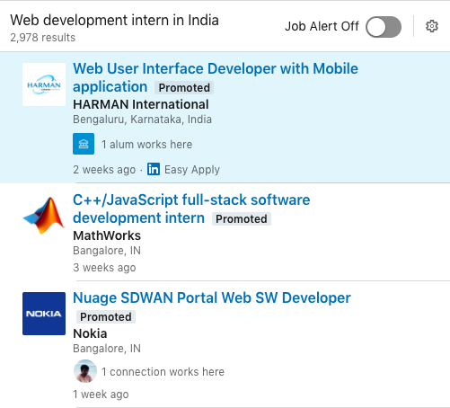
Scope of Web Development
Web Development intern in India
2978 Results
Source: LinkedIn
Date : Aug 22, 2019

Slide 31
SALARY
As a Fresher
10,000 to 25,000 (INR)
After 2-3 years of experience
25,000 to 50,000 (INR)
Professionals
6 figure income

Slide 32
Are you ready to contribute ?

Slide 33
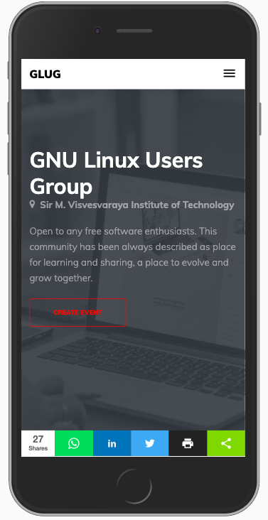
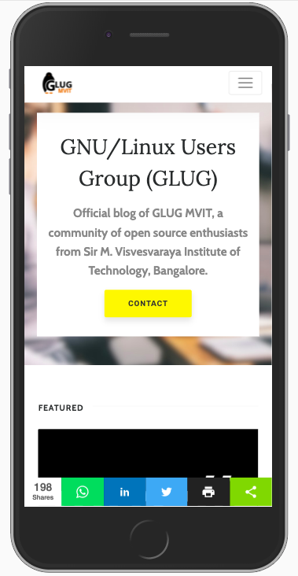
GLUG MVIT
https://www.glugmvit.com
https://blog.glugmvit.com

Slide 34
Resources and Websites

Slide 35
World Wide Web Consortium The organization responsible for creating official web standards http://www.w3c.org/
W3Schools Online web tutorials (also contains web statistics) http://www.w3schools.com/
Coursera
https://www.coursera.org
Edx
https://www.edx.org/

Slide 36
Web Style Guide A thorough and accessible guide to Web design http://www.webstyleguide.com/
Jacob Nielsen’s Use It A web site devoted to accessibility issues http://www.useit.com/
Cool HomePages.com A listing of the “coolest” home pages http://www.coolhomepages.com/
Vincent Flander’s Web Pages That Suck Learn good design by looking at poorly designed web sites http://www.webpagesthatsuck.com/

Slide 37
Web Site Optimization Analyzer Analyze time it takes for web site to load http://www.websiteoptimization.com/services/analyze/
Web Browser Statistics http://www.w3schools.com/browsers/browserstats.asp
disABILITY Information and Resources A listing of web sites to help make web pages more accessible http://www.makoa.org/
Lynx Viewer Emulations of lynx (text web browser) http://www.delorie.com/web/lynxview.html http://www.yellowpipe.com/yis/tools/lynx/lynx_viewer.php

Slide 38
WebTV Viewer An emulation of the WebTV browser http://developer.msntv.com/Tools/WebTVVwr.asp
HTML Validator Validates HTML code http://validator.w3.org/
Bobby Accessibility Validator Validates web sites for accessibility issues http://bobby.watchfire.com/
August 2005 Connection Speed Statistics: http://www.websiteoptimization.com/bw/0508/

Slide 39
LET’S ANSWER SOME QUESTIONS

Slide 40
What is the acronym of www

Slide 41
What is the acronym of www
world wide web

Slide 42
Which one of these is used in Server Side Development?
Django
HTML5
CSS

Slide 43
Which one of these is used in Server Side Development?
Django

Slide 44
Which of the following tasks or elements would be considered back-end ?
A) Graphic interface
B) Database programming
C) PHP Scripts
D) HTML programming
E) Interface design

Slide 45
Which of the following tasks or elements would be considered back-end ?
B) Database programming
C) PHP Scripts

Slide 46
What is the acronym of https

Slide 47
What is the acronym of https
Hypertext Transfer Protocol Secure

Slide 48
ADITYA RAMAN
LinkedIn
www.linkedin.com/in/ramanaditya
GitHub
https://github.com/ramanaditya
www.adityaraman.ml
adityaraman96@gmail.com

Slide 49


